Slide 1
Python Project
By:
Chakas,Sharry
Flores,Allandre
Remiendo,Nico

Slide 2
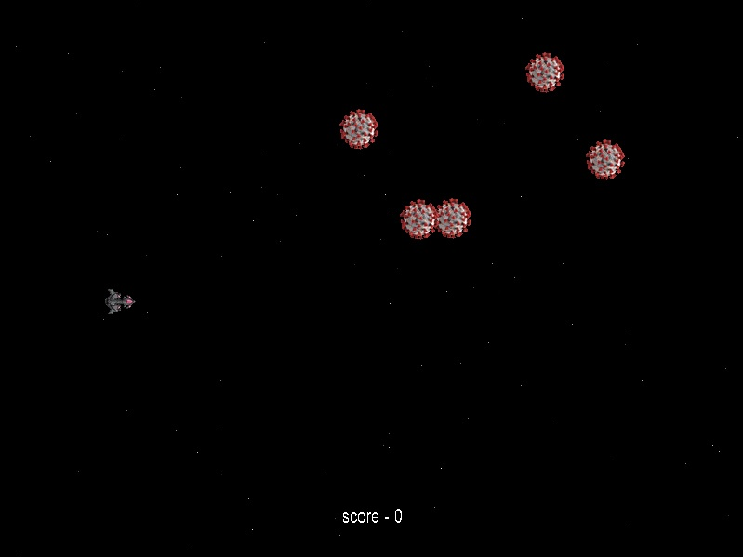
Space Ship Game
The game is called Space Ship Game
At first you need to kill the viruses to gain
Score to reach another level
-Everytime the virus passes your score will be
Deducted
-if the virus hit you ,you will instantly die and the
Score will reset.

Slide 3


Space Ship Game
Level 1 Enemy
Level 2 Enemy
Level 3 Enemy

